Slide 1
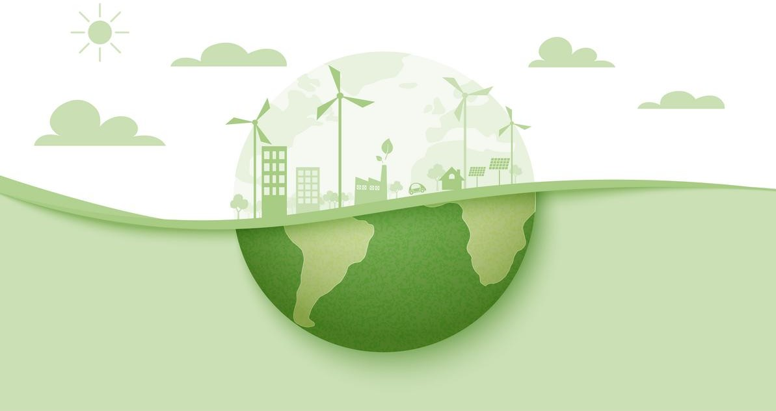
How does the consumption
of meat and vegetables affect
the Environment in
Europe
Sustainable Development
Done by:
Catarina Camarate cs125875 Delfina Larghi dl126096
Lorena Gasse lg126332
Luis Silvano ls126206

Slide 2








Index
Features and Systems of Meat and
Vegetables 7
Introduction 3
Meat and Vegetables European 4 Consumption Analysis
Solutions for Guarantee the Preservation of the Environment
8
Should We Eat Less Meat (Video) 6
Conclusion 9

Slide 3



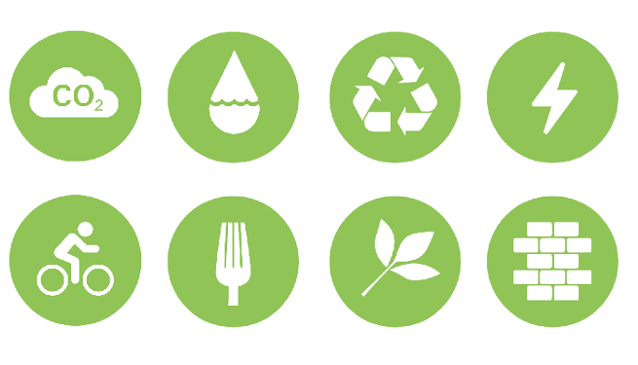

Introduction
This Presentation aims to concern
We desire to realize what is the worst for the world’s
with the
conditions of the environment for future generations.
environment consumption vegetables countries
it is the of meat or in
European
taking into
account their vegetables
and meat production, water resources available, and emissions released to the environment in their production.
Portugal

Slide 4
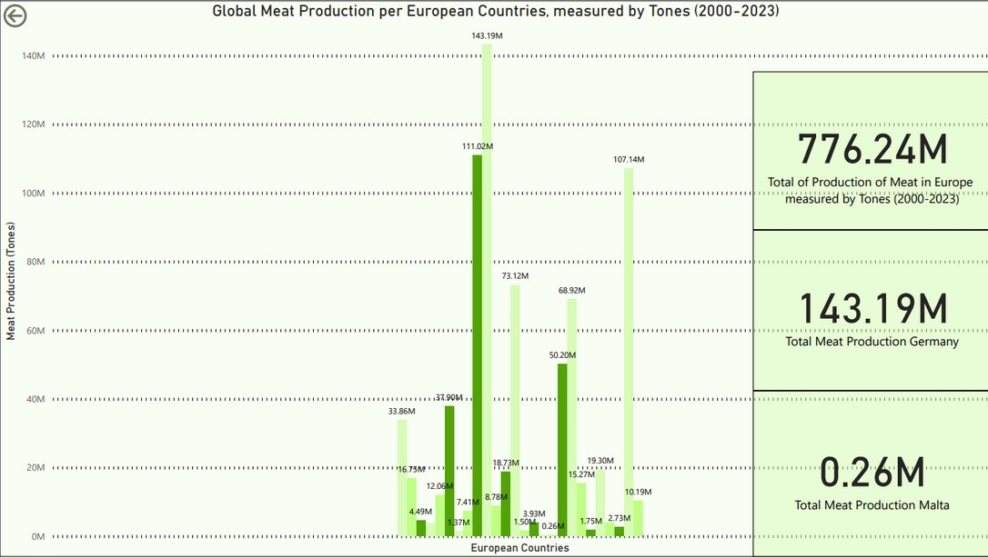
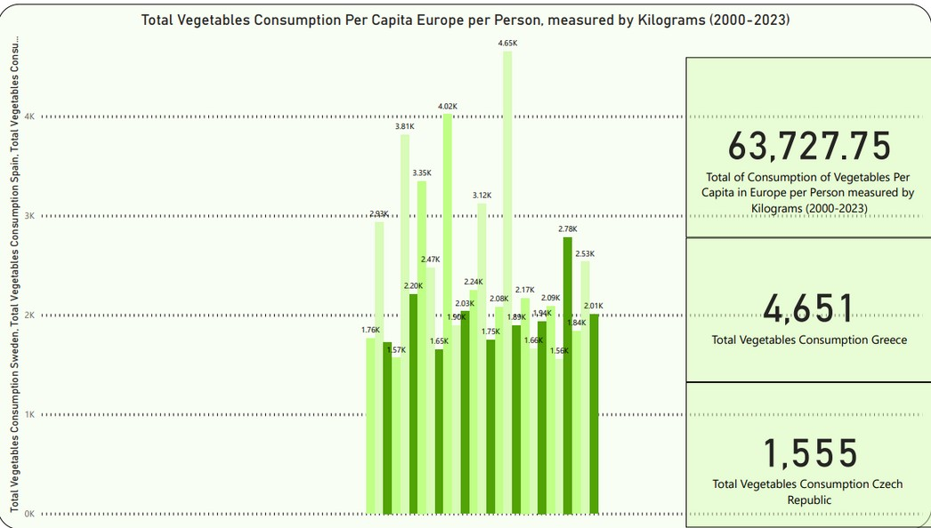



Meat and Vegetables European Consumption Analysis
Meat Global Consumption, measured in Tones (2000-2023) Vegetables European Consumption Per Capita, measured in Kilograms (2000-2023)
1.72K
3.63M
Portugal
We can observe from the graph that in the last 20 years, Europeans Per Capita per Person, consumed 64000 Kilograms of Vegetables.
Greece was the country with the higher consumption of Vegetables, per Kilogram in the last 20 years.
The Czech Republic had the lowest Vegetable consumption,
per Kilogram in the last 20 years.
We can observe from the graph that in the last 20 years,
Europeans consumed 776 Millions Tones of Meat.
Germany was the country with the higher consumption of Meat, per Tones in the last 20 years.
Malta was the country with the lower consumption of Meat, per Tones in the last 20 years.
4

Slide 5

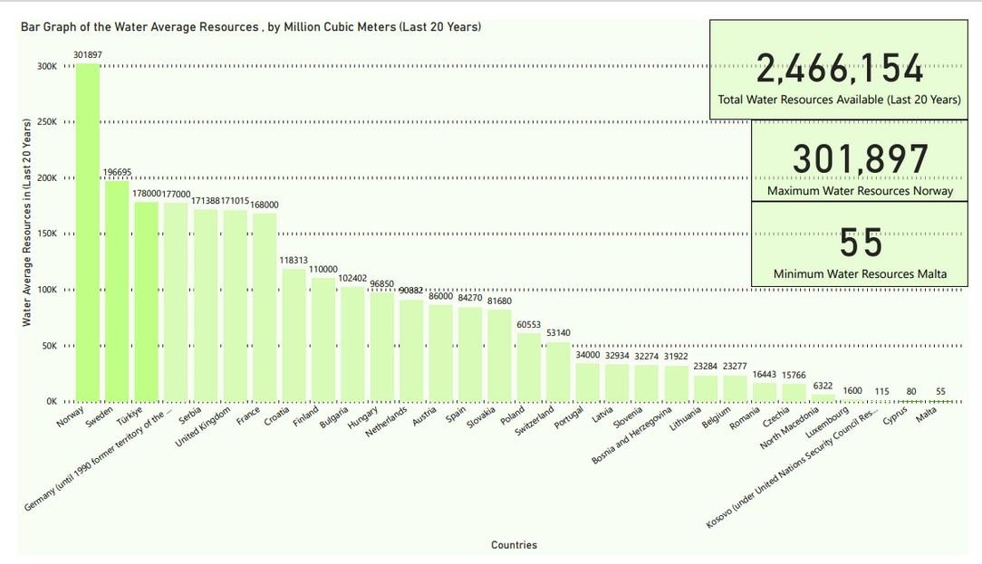

Meat and Vegetables European Consumption Analysis (2)
Water Average Resources, by Million Cubic Meters (2000-2023)
We can observe from the graph that in the last 20 years, Europeans all average water resource, is 2466 million cubic Meters. cubic Meters.
Norway had the higher Water Average Resources in the last 20 years.
Malta had the lowest Water Average Resources in the last 20 years.
Portugal

Slide 6

Should We Eat Less Meat? (Video)

Slide 7

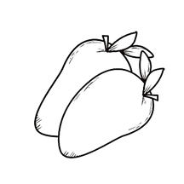
Resources related to Water:
Features and Systems of Meat and Vegetables
Resources related to Carbon Dioxide:
15.415L
99.48Kg
To produce one kilogram of beef and lamb.
To produce one kilogram of beef and lamb.
322L
0.4Kg
To produce one kilogram of vegetables.
To produce one kilogram of vegetables.

Slide 8
Solutions to Guarantee the Preservation of the Environment
1S: Reduce the Consumption of Meat.
2S: Invest in Research and Innovation
Methods.
4S: Reduce Food Waste.
3S: Invest in Sustainable Farming
practices.
5S: Prioritize Local and Seasonal Products
6S: Conservate Natural Resources

Slide 9

Conclusion
The main conclusion from our analysis is that the high consumption of meat in our daily lives has had a higher impact on the environment compared to vegetables in European Countries according to the last 20 years. Therefore, we should follow our solutions for a better environment, so future generations can have a healthy environment that can last longer in the next years.

Slide 10

Thank you for
your attention!
10

